Slide 1
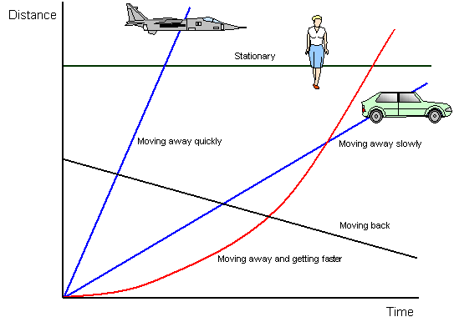
Plotting Straight Line Graphs

Slide 2
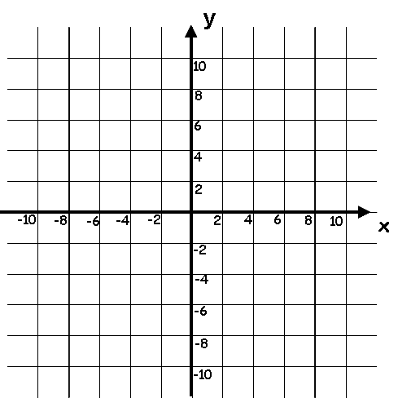
Starter
Recognising some graphs…

Slide 3
Plotting Straight Line Graphs
Learning Objectives
All will be able to plot graphs of equations in the form “y = mx + c” (Grade C/B)
Most will be able to plot graphs of equations that are arranged differently (Grade B)
Some will be able to solve Simultaneous Equations by plotting them as graphs (Grade A)

Slide 4
Plotting Straight Line Graphs
Today we are going to look at plotting graphs on a set of axes
Any equation can be plotted in this way, and will have two features that define it
Its gradient, (steepness)
Where it crosses the y-axis (y-intercept)
You need to be able to recognise both of these features from an equation alone, or from a graph which is already drawn
Same gradient, different y-intercept
Same y-intercept, different gradient

Slide 5
Plotting Straight Line Graphs
To plot a graph, you need to know at least 3 points (why?)
Plot a graph of the equation;
y = x + 6
y = x + 6
Choose any values for x, what y value will go with them?
x = 0
y = 6
(0,6)
x = 1
y = 7
(1,7)
x = 2
y = 8
(2,8)

Slide 6
Plotting Straight Line Graphs
To plot a graph, you need to know at least 3 points
Plot a graph of the equation;
y = 3x + 2
y = 3x + 2
Choose any values for x, what y value will go with them?
x = 0
y = 2
(0,2)
x = 1
y = 5
(1,5)
x = 2
y = 8
(2,8)

Slide 7
Plotting Straight Line Graphs
To plot a graph, you need to know at least 3 points
Plot a graph of the equation;
y + x = 4
y + x = 4
Choose any values for x, what y value will go with them?
x = 0
y = 4
(0,4)
x = 1
y = 3
(1,3)
x = 2
y = 2
(2,2)

Slide 8
Plotting Straight Line Graphs
Plot both the following equations on the same set of axes…
2x + y = 7
y = 2x – 5
You need at least 3 points for each equation, before you can accurately plot them…
y = 2x - 5
2x + y = 7
y = 2x - 5
x = 0
y = 7
(0,7)
x = 0
y = -5
(0,-5)
x = 1
y = 5
(1,5)
x = 1
y = -3
(1,-3)
x = 2
y = 3
(2,3)
x = 2
y = -1
(2,-1)
2x + y = 7
So the values x = 3 and y = 1 will work in BOTH equations!

Slide 9
Plenary
What if you were asked whether a co-ordinate is on a particular line…
Is the co-ordinate (3,4) on the line y = 2x + 2?
y = 2x + 2
4 = (2x3) + 2
Is doesn’t work, and so that co-ordinate will not be on the line of the above equation…
Does the equation ‘balance’ if you substitute the values you’re given?

Slide 10
Plenary
What if you were asked whether a co-ordinate is on a particular line…
Is the co-ordinate (2,8) on the line 2y = 10x - 4?
2y = 10x - 4
(2x8) = (10x2) - 4
Is does work, and so that co-ordinate will be on the line of the above equation…
Does the equation ‘balance’ if you substitute the values you’re given?

Slide 11
Plenary
What if you were asked whether a co-ordinate is on a particular line…
Is the co-ordinate (-2,5) on the line 2y = 4x - 3?
2y = 4x - 3
(2x5) = (4x -2) - 3
Is doesn’t work, and so that co-ordinate will not be on the line of the above equation…
Does the equation ‘balance’ if you substitute the values you’re given?

Slide 12
Plenary
2D Games – possible use of line equations and coordinates?
Missile Command
Asteroids

Slide 13
Plenary
Possible Application
Often in video games, computers have to work out whether objects ‘collide’
For example, trying to hit a ball with a baseball bat
Or trying to fire a shot at another player
How might the computer do this?
Both players can be modelled as coordinates
Based on the angle of the shot, the computer will calculate the equation of the line
It will then check whether the equation intersects with the second coordinate
If it does, then the computer knows there was a ‘hit’

Slide 14
Plenary
In reality, this is inaccurate, as each player occupies a range of coordinates rather than just one
What designers then did was to model each player as a circle
A circle has an equation which could look like this
(x – 4)² + (y + 1)² = 30
→ The computer will then effectively check whether the circle equation and the line equation have any ‘common coordinates’
Both players can be modelled as coordinates
Based on the angle of the shot, the computer will calculate the equation of the line
It will then check whether the equation intersects with the second coordinate
If it does, then the computer knows there was a ‘hit’

Slide 15
Summary
We have looked at plotting a straight line
We have seen how to check whether a co-ordinate is on a line
We have also looked at 2 equations on the same set of axes…

